Slide 1
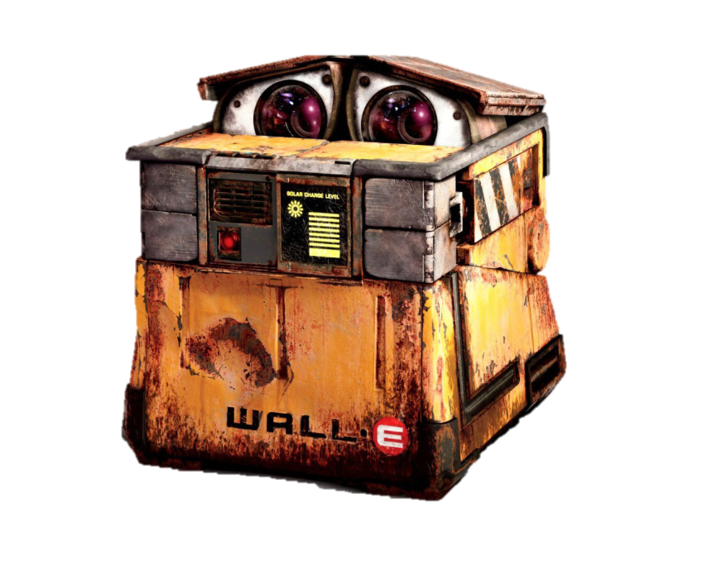
Decentralized Collective Construction
Swarm Robotics and Stigmergy
Complete Simulation Suite
SAP2000 v15
Python
Structural Inputs
Stress
Strain
Deflection
Moment of force
Construction Algorithm

Slide 2
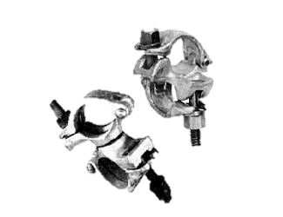

Physical Inputs
Focus on Moment of Force
Joints and beams with readouts
Stigmergy
Stress, axial force, torque?
Beams great at handling axial force
Less important to structural stability
Deflection
Difficult to read locally

Slide 3
Construction
1.0 kips-in local check
Too sensitive

Slide 4
Construction
Attempt to simply lower the limit
Structure built, robot stuck on reinforcing base
Sliding Scale
0.16 kips-in to 4.1 kips-in

Slide 5
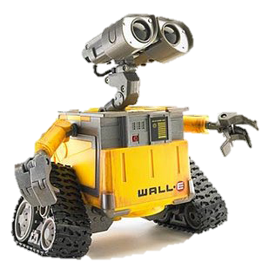
Future Steps
Code Improvements
Debug errors as they pop up
Output .wmv/.mp4 files of simulation
Automatic graph generation
Construction Improvements
Mitigate steepness of moment change
Improve sliding scale
Don’t build vertically
Further Research
Add lateral load (wind)
Improve robot simulation (add moment to simulate hanging)
Multiple robots (swarm)

Slide 6
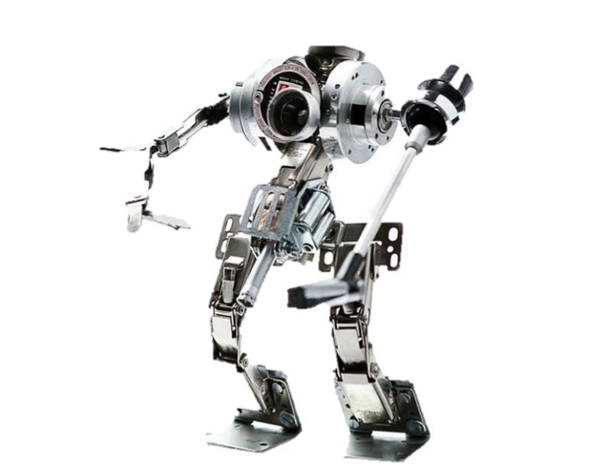
Post-Summer
Rules for more complex structures:
Crossing a gap (bridge)
Large storage area (warehouse)
Multiple materials/ Specialized robot classes
Space Station
Underwater
Extreme Environments (Mars)
Physical Prototypes

